Slide 1
Vehicle Extrication Training

Slide 2
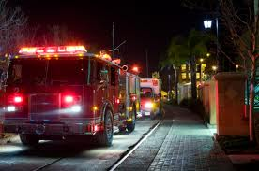
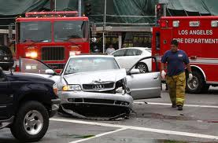
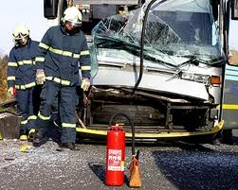
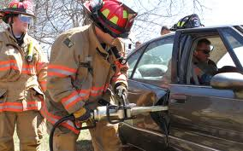
Objectives
Safe positioning of the apparatus
Initial size-up and scene survey
Hazard mitigation
Extrication plan
Reference NFPA 1670 Ch. 6, NFPA 1006

Slide 3
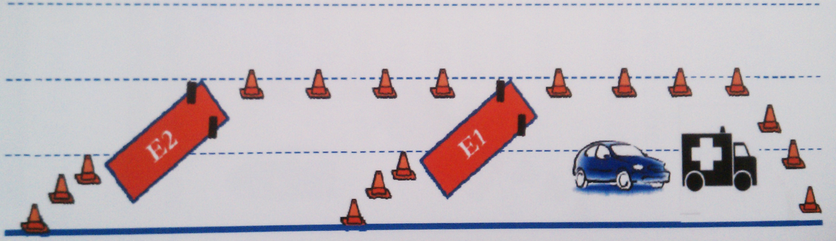
Arrival & Positioning
Safe Positioning of Apparatus
Establish safe operating zone, shield work area
Maintain transportation corridor

Slide 4
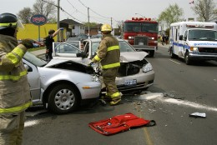
Size-Up
Size-Up & Scene Survey
Pre-arrival will have considered:
  Number & type of vehicles
  Confirmed entrapment
  Hazards involved (power lines, hazmat, environmental)
Windshield size-up will consider:
  Updated location
  Problem
  Initial actions
  Resource needs

Slide 5
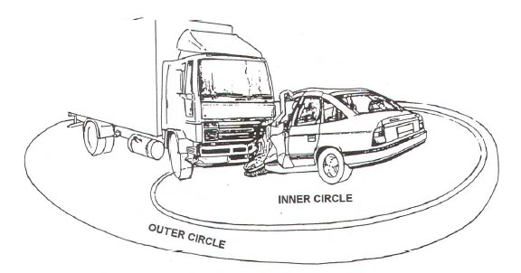
Outer / Inner Circle (360)
Size-Up & Scene Survey
Outer / Inner Circle (360 techniques):
  Outer – additional vehicles, walk away or ejected patients, hazards, back up for inner circle firefighter
  Inner – hot zone survey to check for hazards, number of patients / conditions, entrapment problems, fluid leakage
Do not touch vehicle(s) until 360 is complete

Slide 6
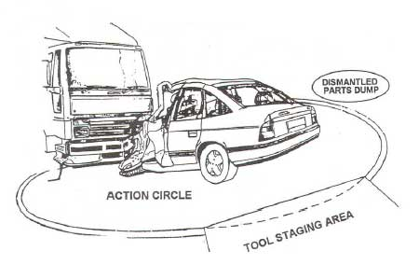
Hazard Mitigation
Initial stabilization (chock wheels)
Hose line or dry-chem extinguisher
Lighting at night
Tool / equipment staging (5-10 yards away)
Debris removal area

Slide 7
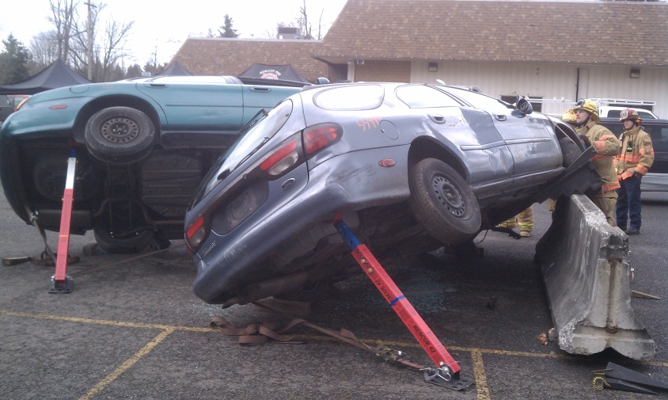
Extrication Plan
Formulate Extrication Plan A, B, C
  Examples: “A” Rear Window Tent, “B” Maxi-door, “C” Rapid Extrication
  Bases stabilization on extrication plan
  Only after extrication plan has been decided can basic & advanced stabilization begin

Slide 8
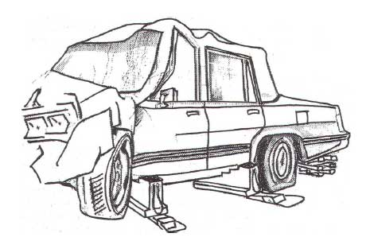
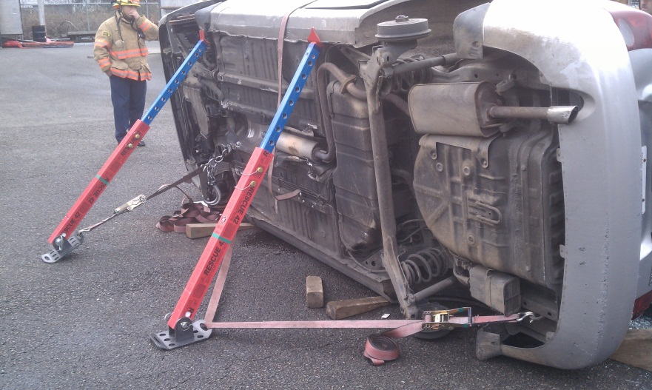
Basic & Advanced Stabilization
Extrication Plan
Basic Stabilization:
  Capture patient compartment with 4-6 points
Advanced Stabilization:
  Use of struts, tie-backs, wreckers

Slide 9
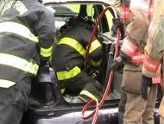
Patient Access & Management
Extrication Plan
Make verbal contact first, give instructions
Access points (door, window)
  Break window furthest from patient to gain entry
  Protect patient when breaking windows
Interior environment and stabilization
  Patient condition, ABC’s, assess entanglement
  Scan for airbags; keep clear of un-deployed bags
  Set brake, shutoff ignition
  Use power accessories to your advantage
  Cover patient
  Gut out interior
  C-spine
  Communicate updates to IC

Slide 10
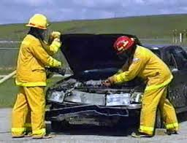
Electrical System
Extrication Plan
Use power to your advantage first
  Power seats, windows, door locks
Disconnect or cut negative (black) cable first
If multiple batteries, do both black cables first
Confirm power shutdown by turning on flashers
Battery may be located in trunk, under rear seat, in wheel wells

Slide 11
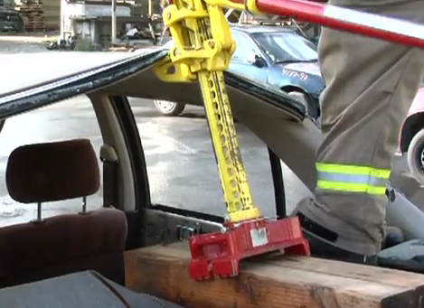
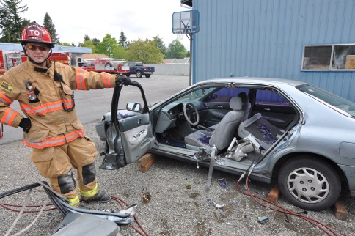
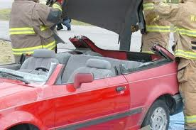
Patient Disentanglement
Extrication Plan
Remove vehicle from around the patient
Two considerations:
  Is there anything pinning the patient?
  What path is the patient going to be removed from the vehicle?
Protect patient with soft and hard protection as needed
Some disentanglement options:
  Rear Window Tent, Maxi-Door, Roof Removal

Slide 12
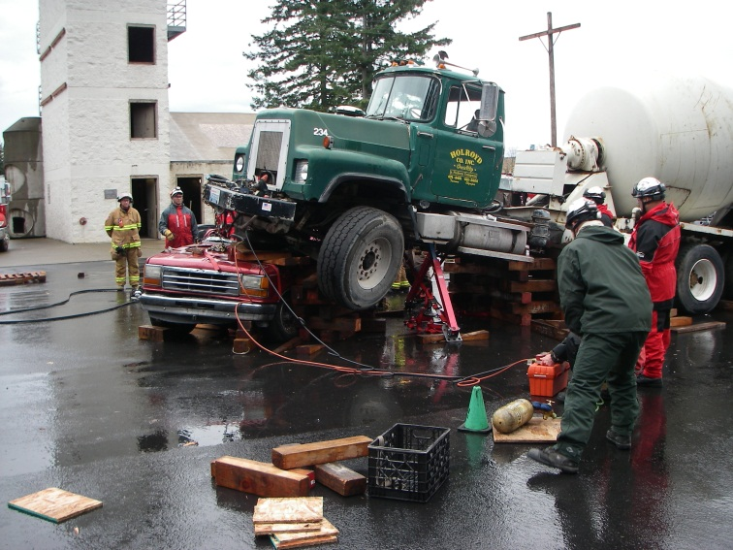
Objectives
Objectives Completed
  Safe positioning of the apparatus
  Initial size-up and scene survey
  Hazard mitigation
  Extrication plan

